Slide 1
Introduction to Geographic Information Systems
Peter Galante
Biodiversity Informatics Specialist
Center for Biodiversity and Conservation
American Museum of Natural History
Notes:
For those of you who took my other class – this is different - you might have some slide repetitions. But overall,
This is includes both more basic and more advanced info, - its broader coverage of topics, and more intensive because its in a smaller amount of time!
1

Slide 2
What is a Geographic Information System?
A Geographic Information System (GIS)
software, hardware, geographic information, spatially explicit data
Software can be used to store, query, manage, analyze and display spatial data.
A GIS links cartographic, statistical, and data-basing technologies.
Notes:
1
GIS also includes people! Operating personnel.
Not just making maps or software – but analysis - spatially explicit analyses.

Slide 3
What is a Geographic Information System?
Data (layers)
Spatial – Images, shape data, geographic information
Tabular – Spreadsheet data with geographic properties
Notes:
1
A lot of the power of GIS has to do with layering – or being able to stack several datasets on top of one another, related by geography.
NOTES: The figure shows how gap analysis was applied to identify biodiversity conservation gaps at the Podocarpus National Park in the southern Andes, Ecuador (Echavarria et al. 1994). As shown in the figure, gap analysis consists of four basic steps:
Map natural assemblages of biotic communities (such as plant or coral cover).
Map the predicted distributions of key biodiversity elements, such as species that breed or use the habitat for an important part of their life history.
Map the managed areas
- Permanence of protection
- Amount of the tract protected
- Inclusiveness of the protection
- Type of management program
Identify gaps in existing biodiversity protection
DISCUSSION POINTS: After going over the process, students are encouraged to consider some potential limitations of gap analysis.
POTENTIAL RESPONSES: These could include: The analysis presumes that vegetation cover can predict vertebrate distribution accurately. It also assumes predicted vertebrate distribution will be a good surrogate for diversity in other groups.
REFERENCE: Fernando R. Echavarria, Ph.D.Sunil Narumalani, Ph.D.Yingchun Zhou, M.S. 1994. GAP ANALYSIS OF THE MONTANA FORESTS OF PODOCARPUS NATIONAL PARK, ECUADOR.
GIS/LIS (1994): 235-244.

Slide 4
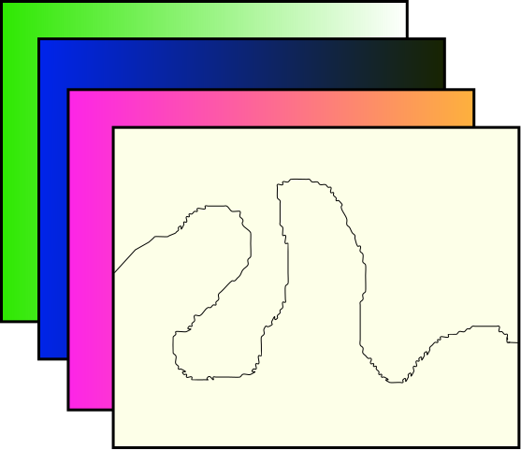
Layering

Slide 5
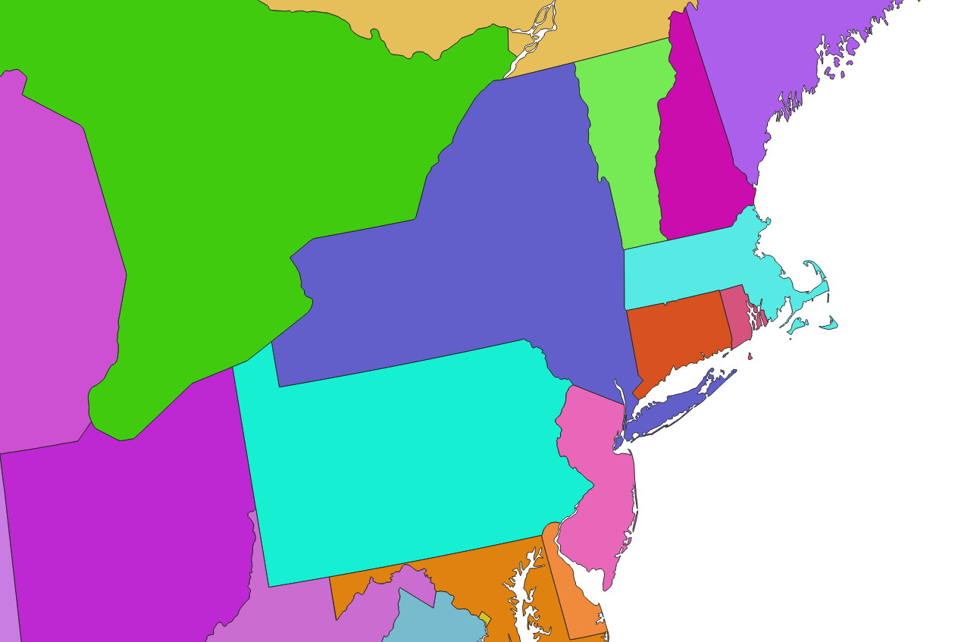
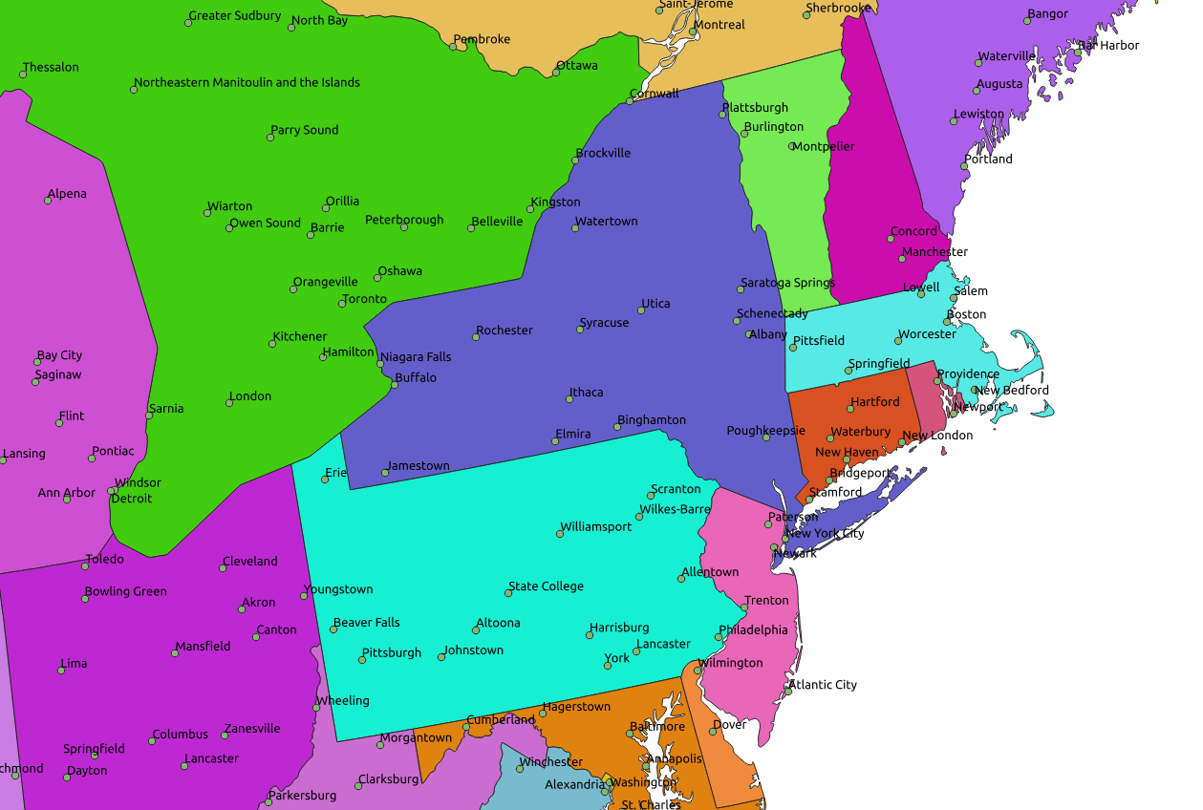
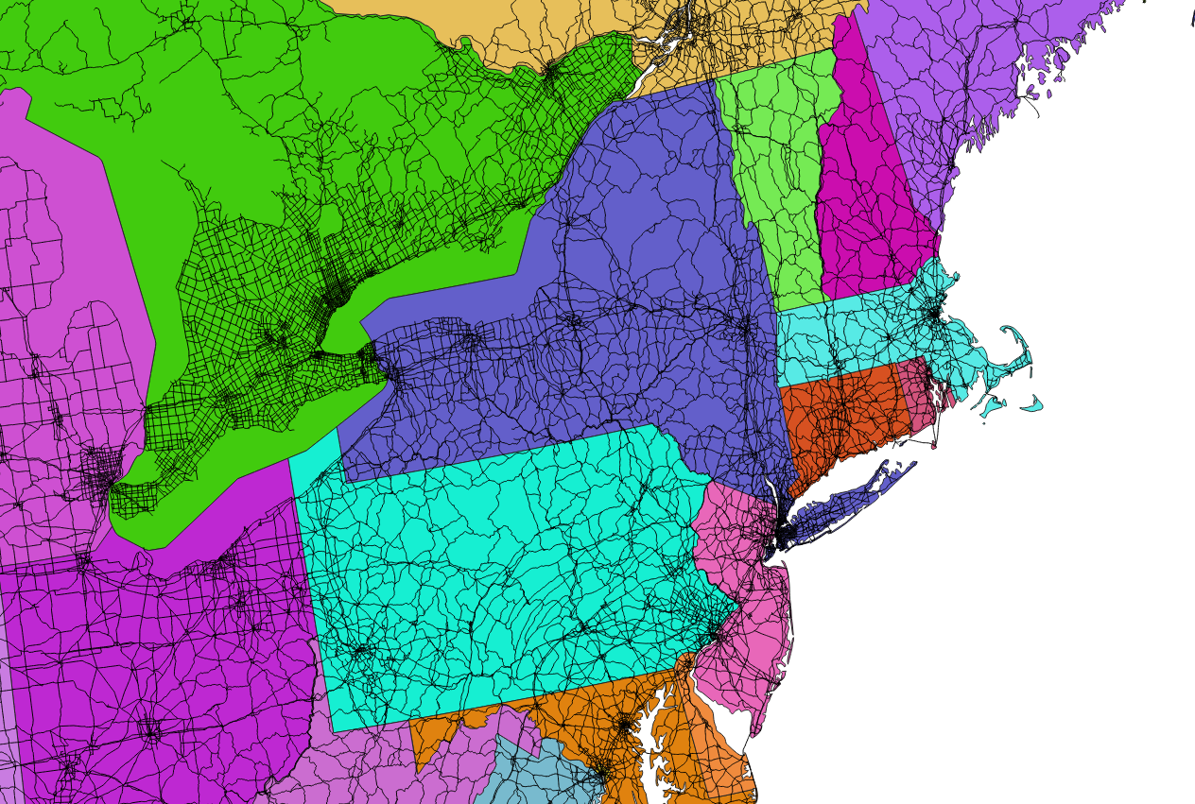
Data from naturalearthdata.com

Slide 6
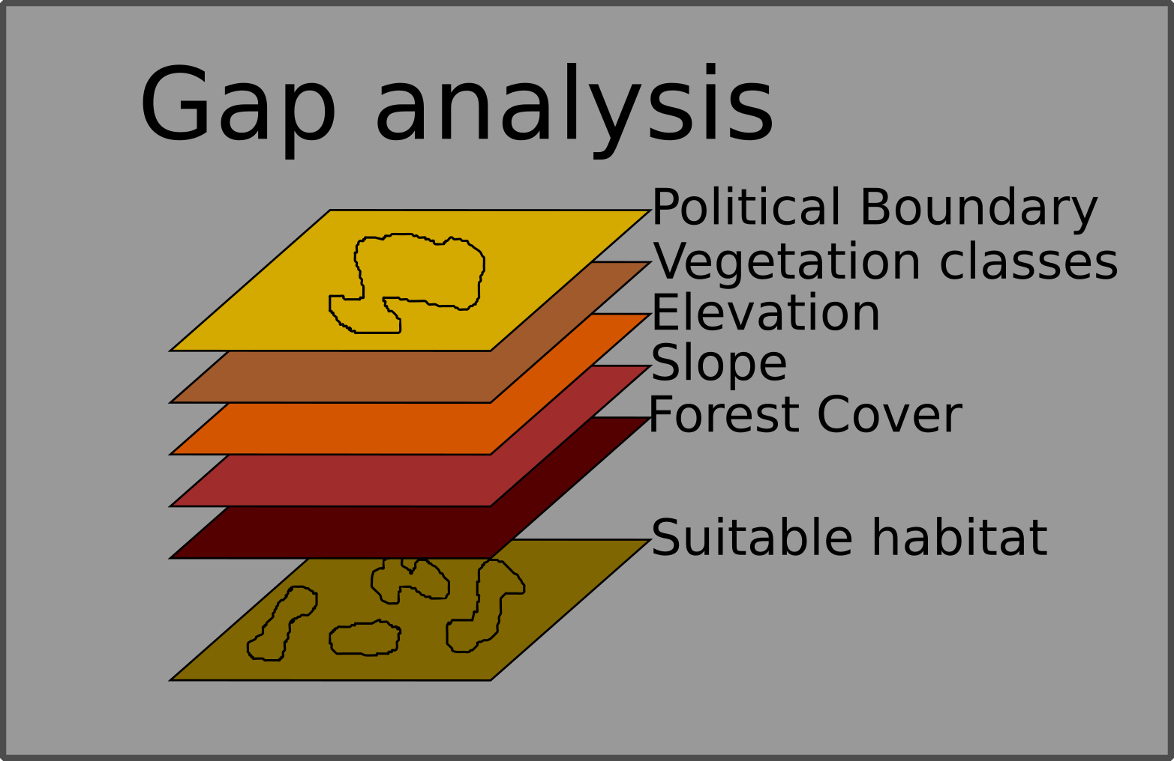
Layering
Notes:
1
A lot of the power of GIS has to do with layering – or being able to stack several datasets on top of one another, related by geography.
NOTES: The figure shows how gap analysis was applied to identify biodiversity conservation gaps at the Podocarpus National Park in the southern Andes, Ecuador (Echavarria et al. 1994). As shown in the figure, gap analysis consists of four basic steps:
Map natural assemblages of biotic communities (such as plant or coral cover).
Map the predicted distributions of key biodiversity elements, such as species that breed or use the habitat for an important part of their life history.
Map the managed areas
- Permanence of protection
- Amount of the tract protected
- Inclusiveness of the protection
- Type of management program
Identify gaps in existing biodiversity protection
DISCUSSION POINTS: After going over the process, students are encouraged to consider some potential limitations of gap analysis.
POTENTIAL RESPONSES: These could include: The analysis presumes that vegetation cover can predict vertebrate distribution accurately. It also assumes predicted vertebrate distribution will be a good surrogate for diversity in other groups.
REFERENCE: Fernando R. Echavarria, Ph.D.Sunil Narumalani, Ph.D.Yingchun Zhou, M.S. 1994. GAP ANALYSIS OF THE MONTANA FORESTS OF PODOCARPUS NATIONAL PARK, ECUADOR.
GIS/LIS (1994): 235-244.

Slide 7

Notable GIS software
Commercial:
ArcGIS, including ArcMap (Esri)
IDRISI (Clark Labs)
ERDAS IMAGINE (ERDAS Inc.)
Open source:
Quantum GIS
GRASS GIS
MANIS tool
GPSvisualizer
Biogeomancer
Free (but not open source):
DIVA GIS
Notes:
This list is a bit out of date -
1

Slide 8
Outline
How do we represent real world geographic information with a computer?
Data models – representations of geographic reality
Scale, spatial autocorrelation
Location information: coordinate systems
Georeferencing, sampling bias
Remote Sensing
Notes:
Basic topics that are really the foundation you need to do any spatially explicit analyses.- with a focus on natural history questions
And another theme today will be sources of bias and error that you need to think about throughout any spatially explicit analysis, because the errors don’t just go away when you represent reality in the computer – they’re still there and they carry through your analysis.
1

Slide 9
Two methods of GIS representation
There are two main ways a GIS can create a logical data model of the world:
Vector = discrete features
Raster = continuous fields
Notes:
Need to simplify the real world.
The two fundamental ways of representing geography are discrete objects an continuous fields. Discrete objects represent the geographic world as objects with well-defined boundaries in otherwise empty space. Continuous fields represent the real world as a finite number of variables, each one defined at every possible position.
Each is more related to a data model (raster or vector – but its not exactly one to one)
I’ll go over each one in a minute in more detail, but first I want you understand that we do this to simplify reality and then analyze it.
1

Slide 10
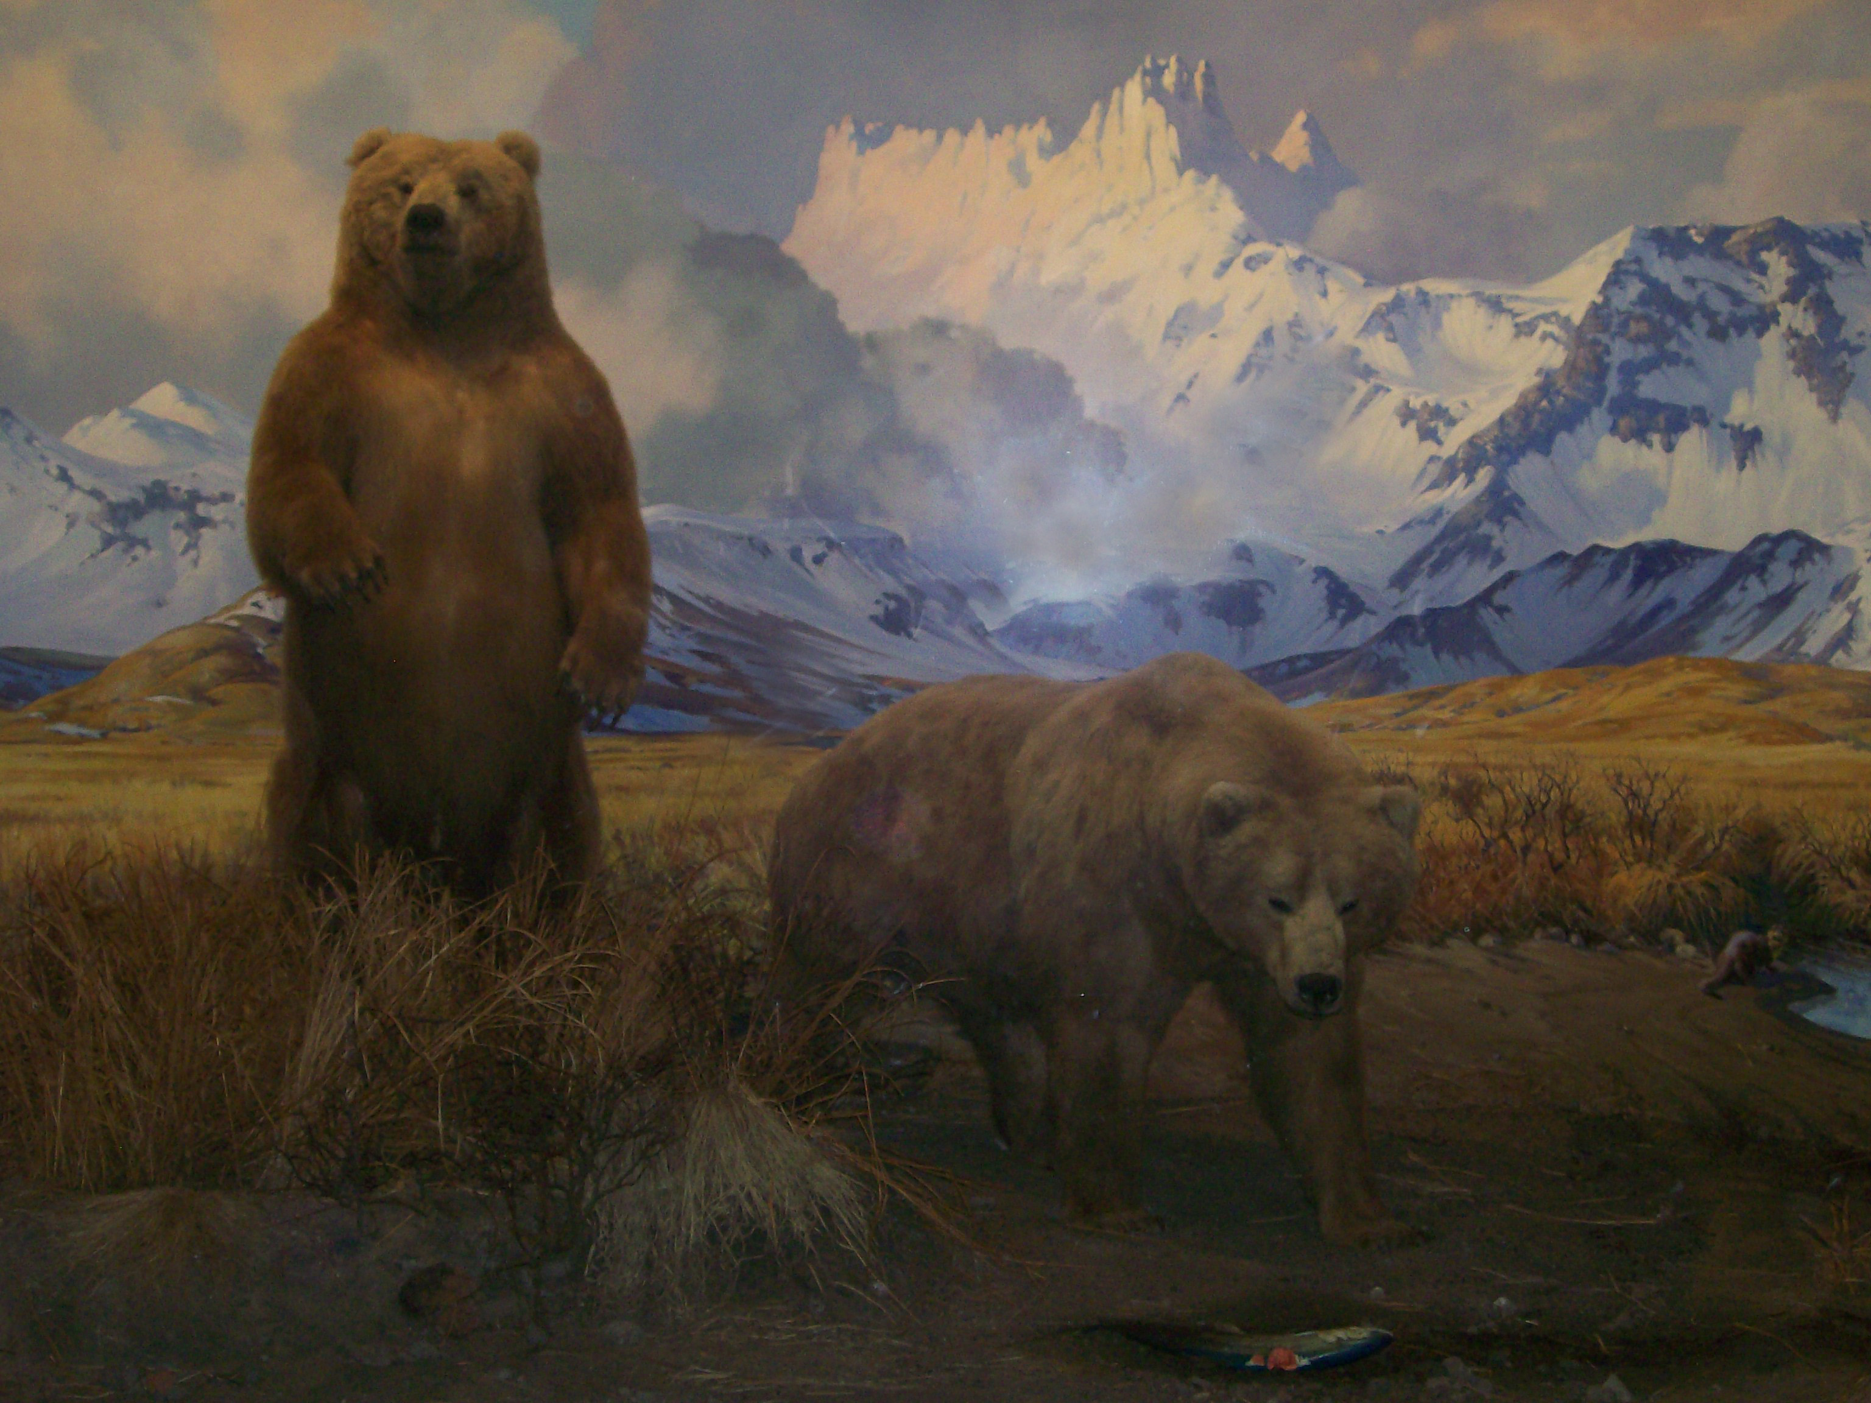
Vector - Discrete Objects
Discrete objects
Represents the geographic world as objects with well-defined boundaries in otherwise empty space
Bears are easily conceived as discrete objects, maintaining their identity as objects through time and surrounded by empty space.
(Alaskan Brown Bear diorama at the American Museum of Natural History)
Notes:
Discrete object view
Envisions the earth's surface as empty geographical space, populated by discrete, bounded objects.
Objects can be classified as points, lines, and polygons, as well as volumes in a 3D view.
Example:
there are millions of examples, but let's just use properties, streets, and trees.
Typically corresponds to the Vector Data Model which we’ll talk about in a moment
Discrete objects: We prefer black and white to shades of grey (as humans).
Points – 0-dimensional
Lines – 1-dimensional
Areas or Polygons – 2-dimensional
The third dimension – can be represented as an attribute (e.g. height of a building
The third dimension is a bit tricky. – continuous field might be better for “third” or 2.5-dimension – digital elevation model.
1

Slide 11
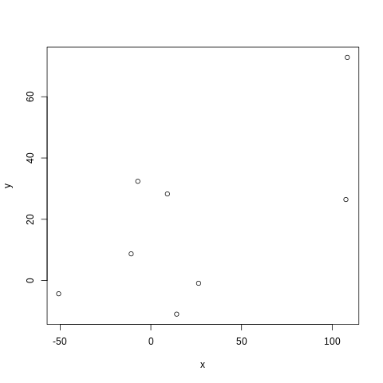
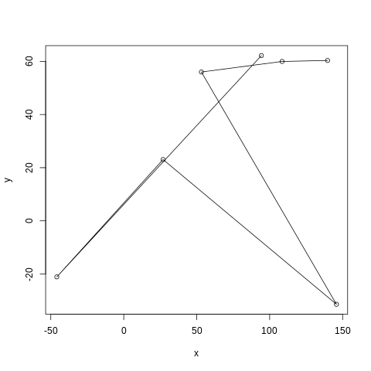
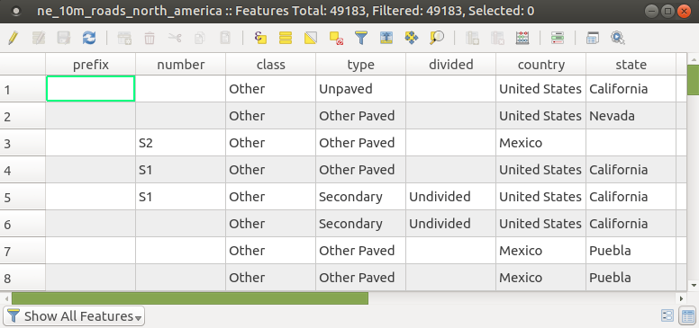
Vector Data
- Vector data represents features as points, lines, and polygons.
- It is best applied to discrete
objects with defined shapes
and boundaries.
- It is tied with tabular data
Examples include:
GPS points from radio telemetry
Roads
Protected areas
Notes:
In vector representation, all lines are captured as points connected by precisely straight lines. Curves are approximated by increasing the density of points. An area is a series of points or vertices connected by straight lines.
We call areas polygons in GIS-speak.
Lines are often called polylines – because curved line is represented by series of straight lines connecting vertices.
In a vector, there is no grid per se. The world is empty space populated by objects, which are basically points, lines, and polygons.
This is the data model employed most typically by ESRI software, although it can handle both.
Originally, the vector model was developed, in part, to respond to limited computer storage capacity.
Vector has a lot of advantages, for example:
Easy to calculate accurate areas of features
Easy to aggregate features into larger features
Easy to store relational databases
1

Slide 12
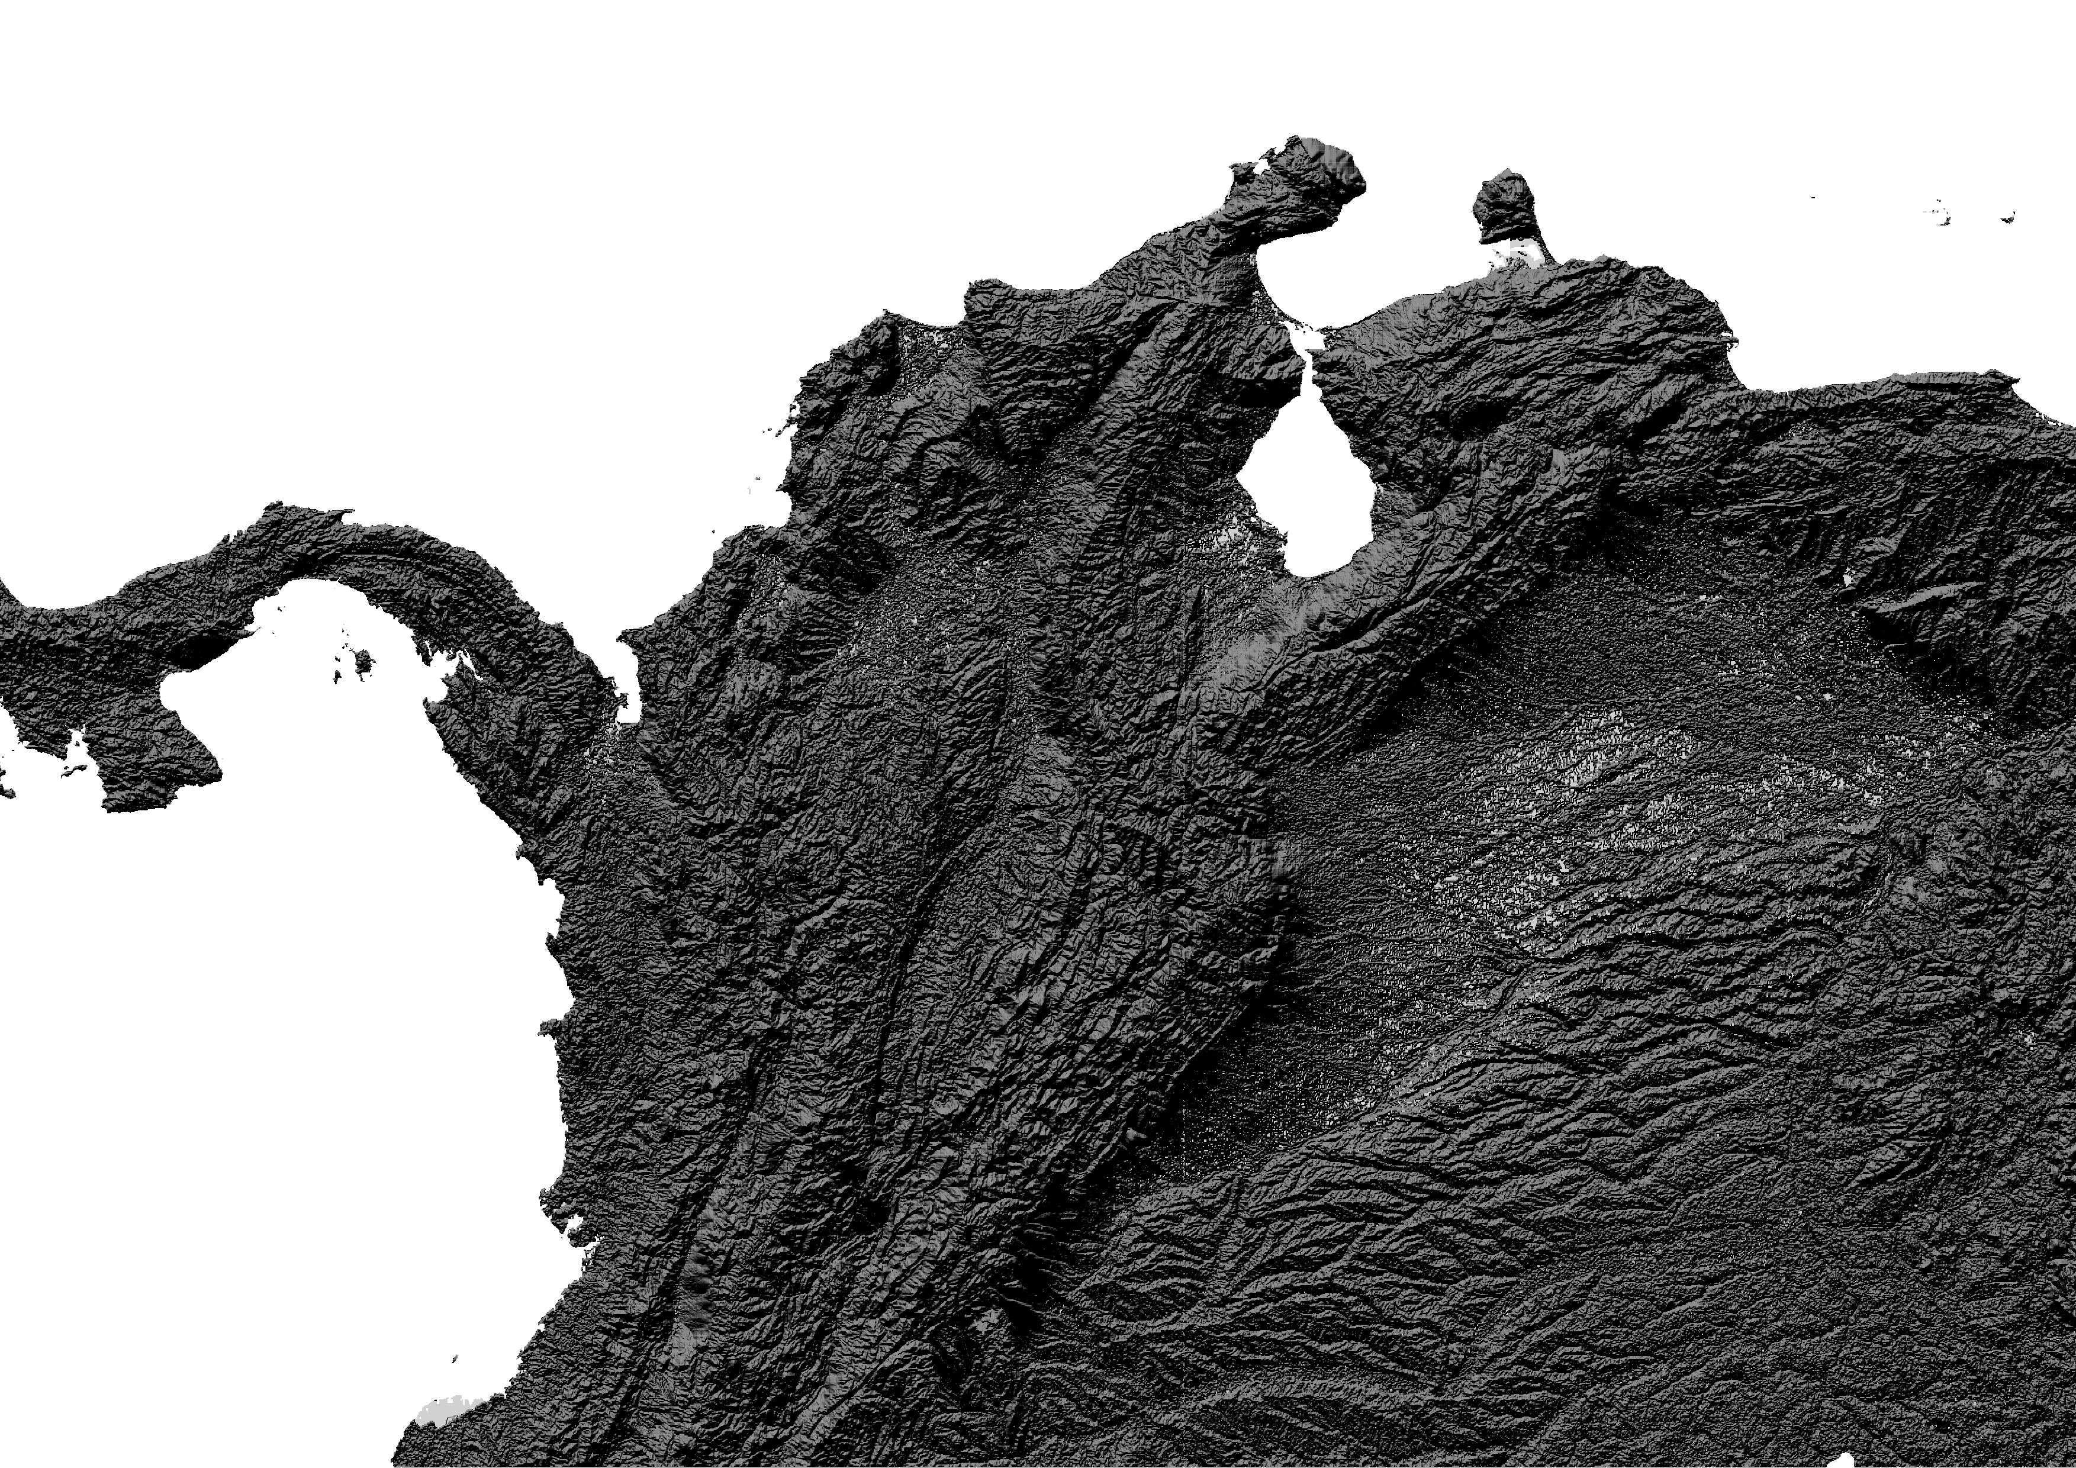
Raster - Continuous Fields
Continuous fields
Represents the real world as a finite number of variables, each one defined at every possible position.
E.g. a Digital Elevation Model
Notes:
Density, land cover, soil type
Continuous field view
This is different: you think of the world as a finite number of variables, and each variable is defined at every possible position.
Continuous fields can be defined by what varies, and how smoothly.
Elevation is a good example of something conceptualized as a continuous field. Every possible location has an elevation; the elevation varies, sometimes smoothly, sometimes not.
Typically related to raster data models (which we’ll talk about later)
1

Slide 13
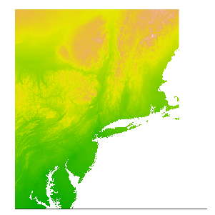
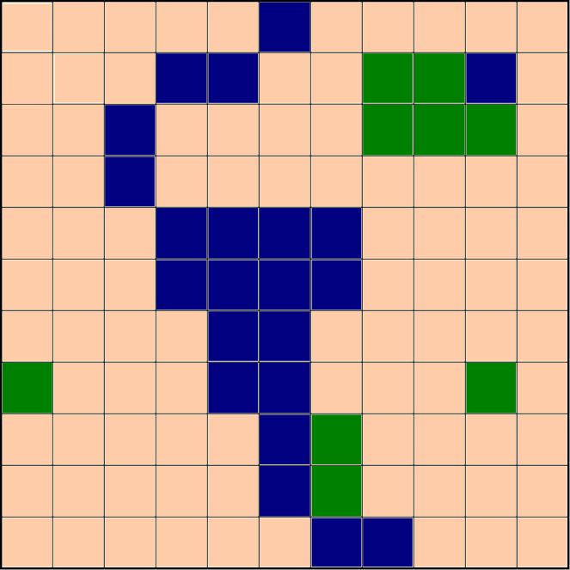
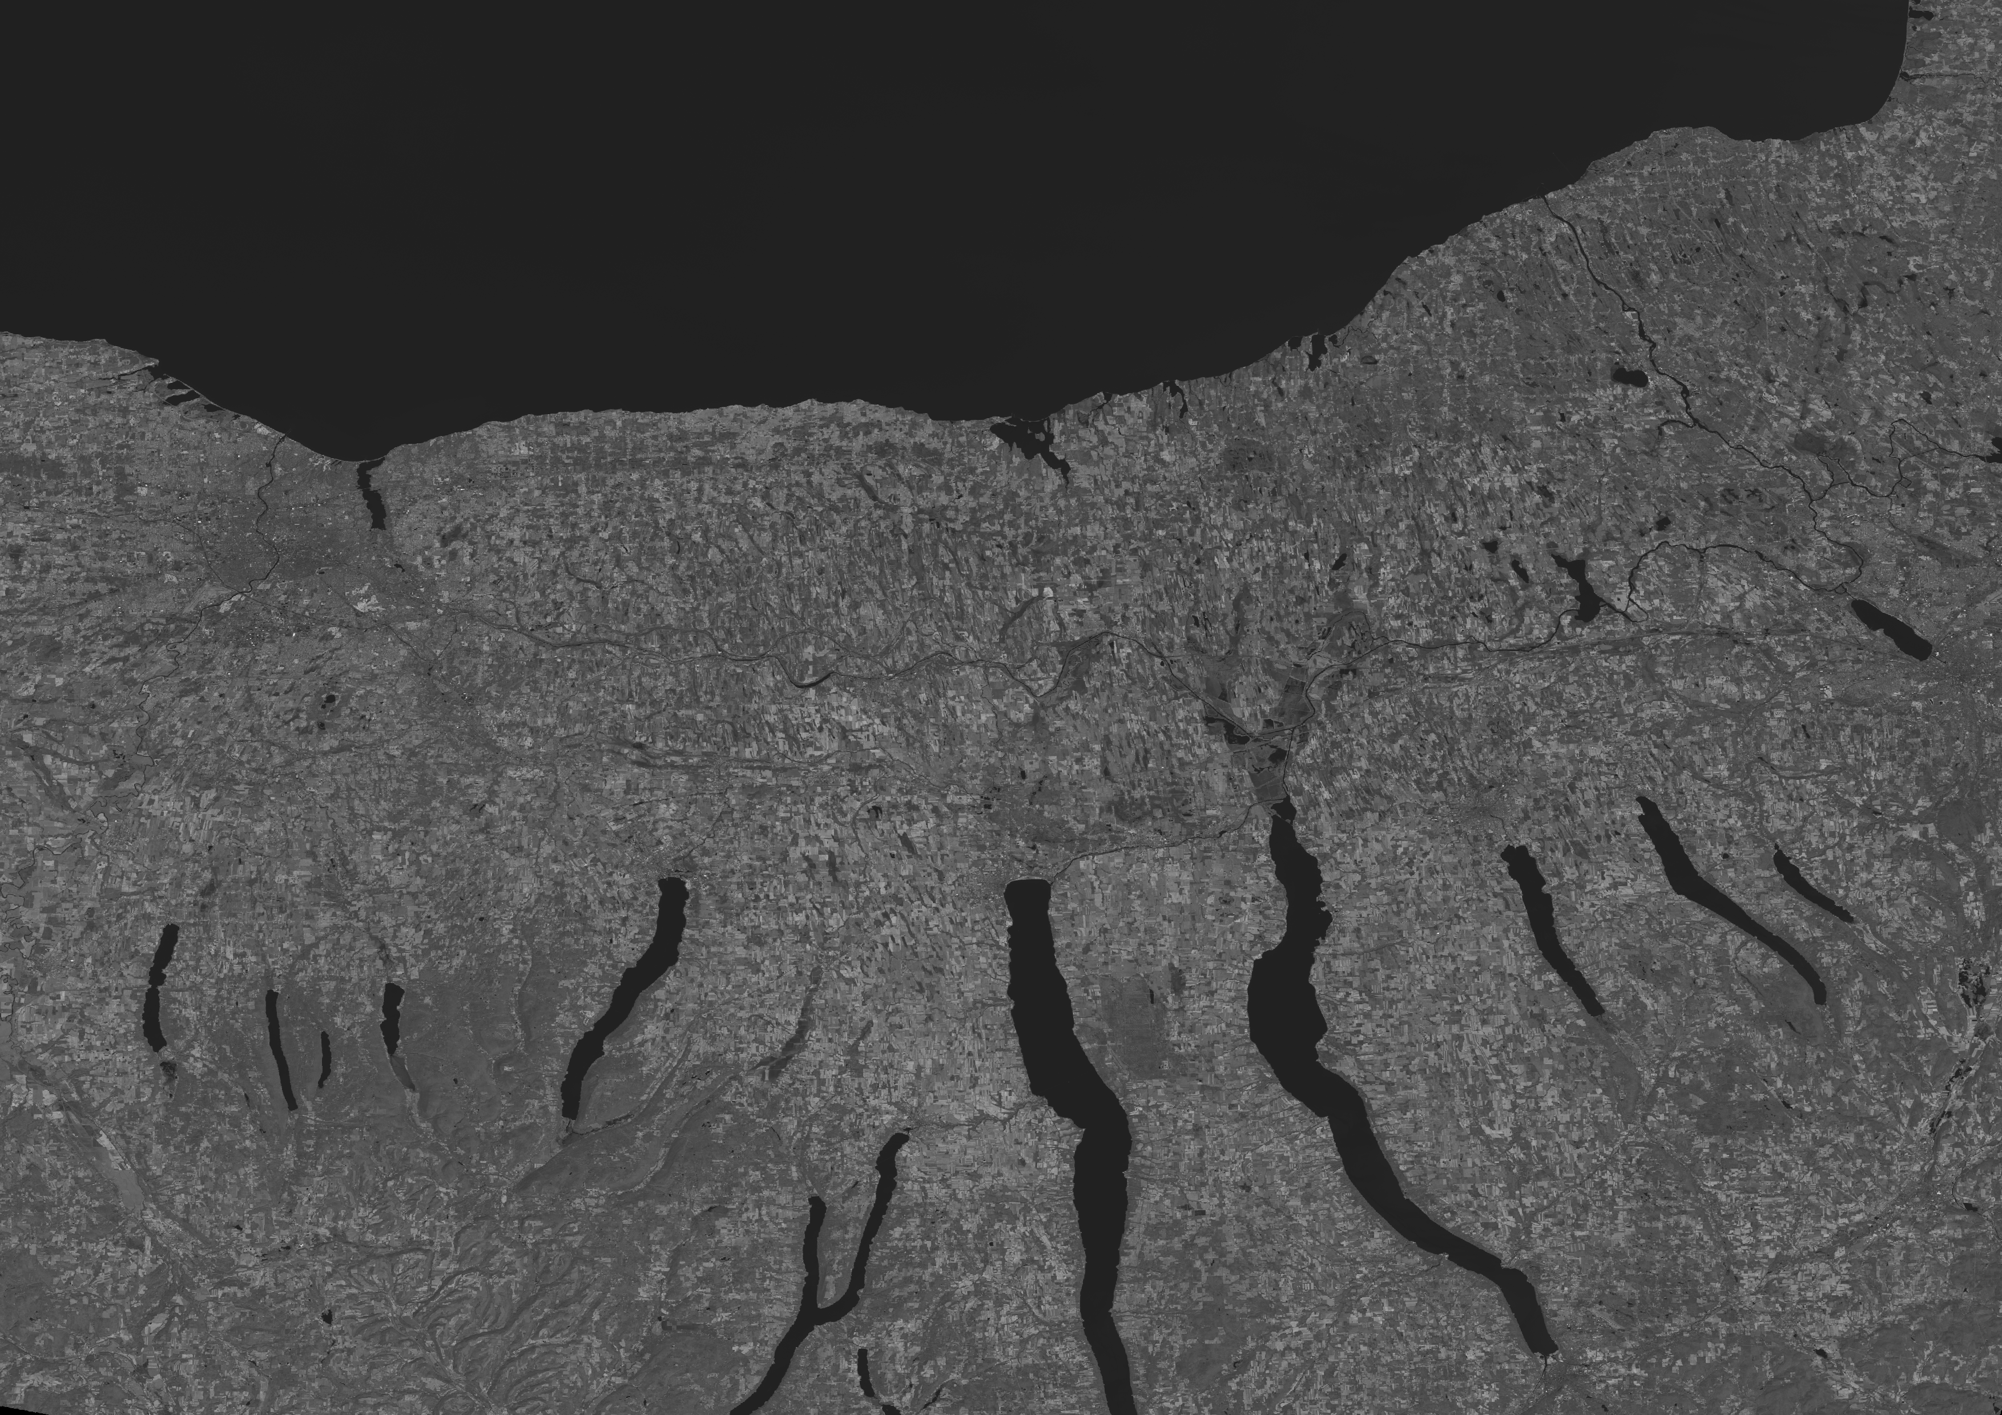
Raster Data
A raster model represents the world as a surface that is divided into a regular grid of cells, each of which are assigned a value.
Raster data includes images and grids.
aerial photograph, a satellite image,
or a scanned map, are often used
for generating raster datasets.
River
Trees
Lake
Grass
Notes:
In a raster, the world is divided into arrays of cells, and each cell is assigned a value for ONE attribute (forshadowing but in vector data a feature can have LOTS of attributes).
The most common forms of raster data are:
Satellite images
Aerial photos
Digital elevation models
The precision of a raster data model depends on the grid size or spatial resolution.
Difference in satellite sensors:
Landsat Thematic Mapper (30 x 30 m)
MODIS (250 x 250 m)
Aerial photos might have sub-meter resolution
Just like paper maps have to be flattened (or projected – we’ll talk about different kinds of projections later) - - raster representations also have to be projected – so cells of raster can never be perfectly equal in shape or area on earth’s surface. (mirrorball)
1

Slide 14
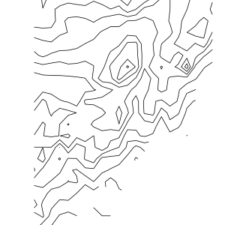
Resolution
RASTER | VECTOR
Resolution is explicit in the size of the grid cells / pixels | Resolution is difficult to define and therefore typically poorly defined (not rigorous)
Notes:
Could use distance between points as a measure of resolution in a vector dataset, but use minimum, mean, maximum, nearest-neighbor?
Creates impression that vector data have infintely fine resolution – false impression, depends on the density of sampling and the strategy of sampling that was undertaken to create the dataset, which unfortunately often remains unreported in the metadata describing vector datasets. In short, vector representations leave resolution poorly defined. And it is difficult if not impossible to infer resolution a posteriori from the contents of a vector dataset – IN principle the poor definition of resolution for vector data is a strong argument for the use of raster data in rigorous scientific research.
1

Slide 15
General data issues: spatial scale
Spatial scale has two elements: resolution and extent
Decrease in resolution
Increase in extent
Resolution and extent tend to be
inversely related
Extent
Resolution
Notes:
1
Scale may also mean Map Scale (representative fraction)
Extent – of study area in geographic space, or time (geographic scope)
Resolution – degree of detail or granularity of data (high or low resolution, fine scale or coarse scale)

Slide 16
Vector data
Advantage
precise representation of points, boundaries, and linear features
defining spatial relationship (connectivity and adjacency) between coverage features
network analysis (for example to find an optimal path between two nodes in a complex transport network)
Disadvantage
boundaries of the resulting map polygons are discrete/enclosed by well-defined boundary lines. In reality the map polygons may represent continuous gradation or gradual change, as in soil maps
Resolution is not clear – how many points were used to make up a line?
Notes:
Precision could be false precision.
1

Slide 17
Raster data
Advantage
Represent indistinct boundaries
thematic information on soil types, soil moisture, vegetation, ground temperatures
Reconnaissance satellites and aerial surveys use raster-based scanners
scanned images can be directly incorporated into GIS
Potential disadvantage
The higher the grid resolution, the larger the data file is going to be
If converting from vector to raster can lose information:

Slide 18
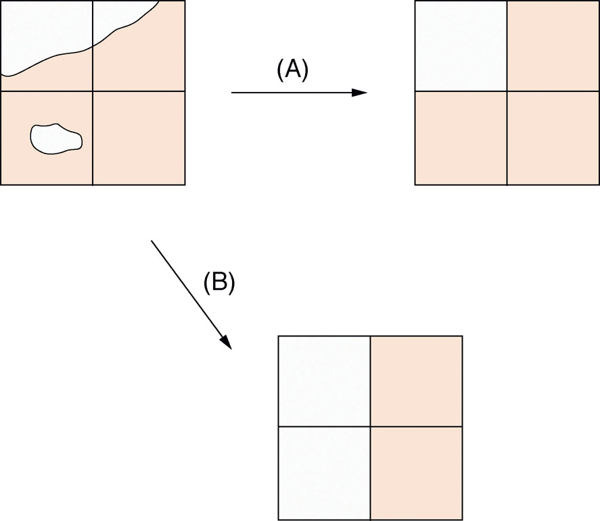
Conversion from vector to raster data
the largest share rule
(B) the central point rule
Notes:
How to you turn a vector into a raster?
When information is represented in raster form, detail about variation within cells is lost – cell has single value.
Problems with raster representation: Rules about how to classify an attribute, how to lose the detail
Choose single value in different ways – central point or largest share of cell’s area.
The largest share rule (A) says if the majority of a grid cell is pink, then its coded pink.
The central point rule (B) says if the centroid of the cell is pink, then its coded pink.
Largest share typically preferred, but central point is faster to compute – often used in creating raster datasets of elevation.
1

Slide 19
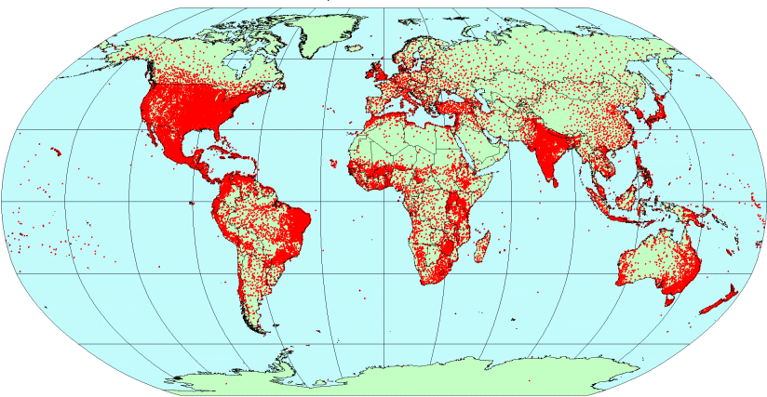
Conversion from vector to raster data
Weather station records
(vector point data;
Hijmans et al. 2005)
Interpolated raster climate surfaces (WorldClim)
Notes:
1
But we do this conversion a LOT and its super important to our work - probably many of you have already or will use the WorldClim global climate layers, which were generated via this conversion, followed by interpolation.

Slide 20
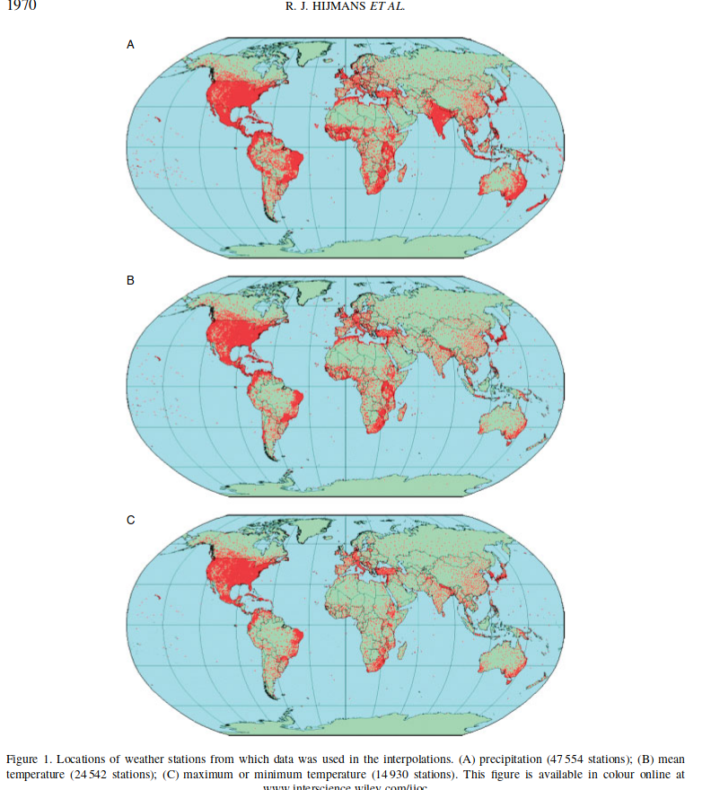
Spatial Interpolation – Hijmans et al., 2005
Notes:
Spatial interpolation is a process that uses this spatial dependence and covariances to fill in gaps in our knowledge of spatial data.
Interpolation proposes to refine the spatial resolution of point data artifically, replacing a finite number of observations with potentially an infinite number – using the theory of regionalized variables that covary over geographic space -
First they measure the correlation between climate variables (temperature, rainfall) and elevation, then you create a regression model to predict temperature from elevation, minimizing residuals, then you get your hands on a fine scale (high resolution) digital elevation model, and then you can get a fine-scale high resolution temperature layer even if you only started with a few weather stations to begin with.
This is called “Kriging” - we won’t go into too much detail because this is advanced geostatistics but it illustrates how knowing about the nature of geographic data – spatial autocorrelation – allows us to analyze …
1

Slide 21
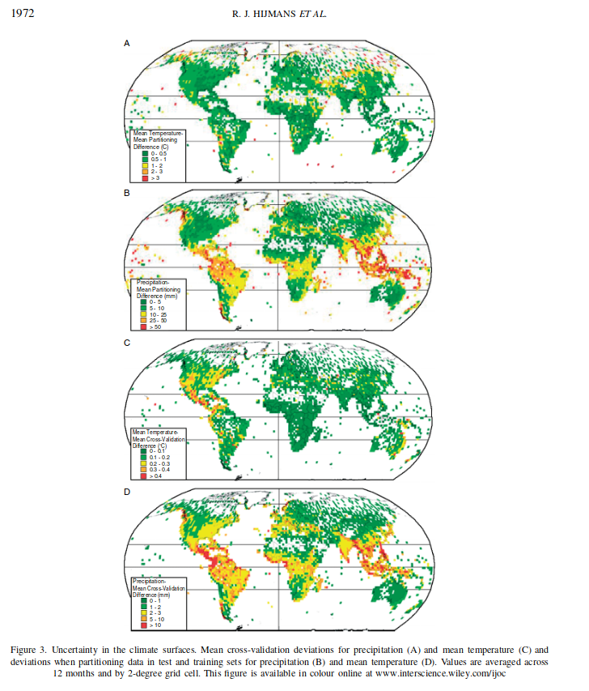
Spatial Interpolation – Hijmans et al., 2005
Notes:
Spatial interpolation is a process that uses this spatial dependence and covariances to fill in gaps in our knowledge of spatial data.
Interpolation proposes to refine the spatial resolution of point data artifically, replacing a finite number of observations with potentially an infinite number – using the theory of regionalized variables that covary over geographic space -
First they measure the correlation between climate variables (temperature, rainfall) and elevation, then you create a regression model to predict temperature from elevation, minimizing residuals, then you get your hands on a fine scale (high resolution) digital elevation model, and then you can get a fine-scale high resolution temperature layer even if you only started with a few weather stations to begin with.
This is called “Kriging” - we won’t go into too much detail because this is advanced geostatistics but it illustrates how knowing about the nature of geographic data – spatial autocorrelation – allows us to analyze …
1

Slide 22
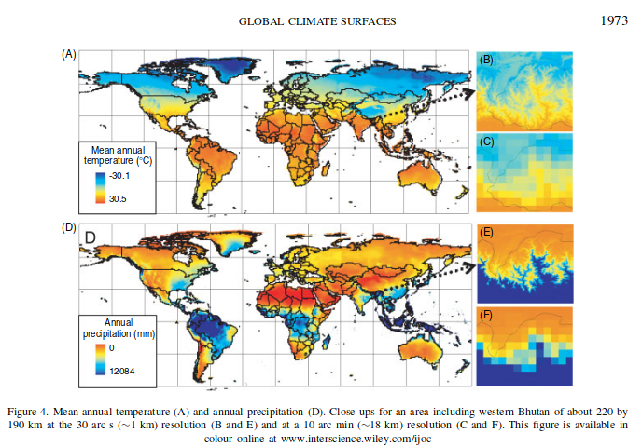
Spatial Interpolation – Hijmans et al., 2005
Notes:
Spatial interpolation is a process that uses this spatial dependence and covariances to fill in gaps in our knowledge of spatial data.
Interpolation proposes to refine the spatial resolution of point data artifically, replacing a finite number of observations with potentially an infinite number – using the theory of regionalized variables that covary over geographic space -
First they measure the correlation between climate variables (temperature, rainfall) and elevation, then you create a regression model to predict temperature from elevation, minimizing residuals, then you get your hands on a fine scale (high resolution) digital elevation model, and then you can get a fine-scale high resolution temperature layer even if you only started with a few weather stations to begin with.
This is called “Kriging” - we won’t go into too much detail because this is advanced geostatistics but it illustrates how knowing about the nature of geographic data – spatial autocorrelation – allows us to analyze …
1

Slide 23
The nature of spatial data
Tobler’s First Law of Geography:
Everything is related to everything else, but near things are more related than distant things.
Most of the things we are interested in are not randomly distributed in space.
Con: Need to correct for spatial autocorrelation and bias in analyses
Pro: Allows for interpolation
Notes:
So that was for when you have too much data – what about when you don’t have enough data, or there are gaps in your data, OR what you want to measure is just so complex (maine coastline) that you have to measure just small parts and not the whole thing – how can you fill in gaps?
Our representations of the world are necessarily selective of reality, and inherently incomplete.
So, when building representations we often end up with gaps in our data.
How do we fill in the gaps? Spatial interpolation. And proximity effects
1

Slide 24
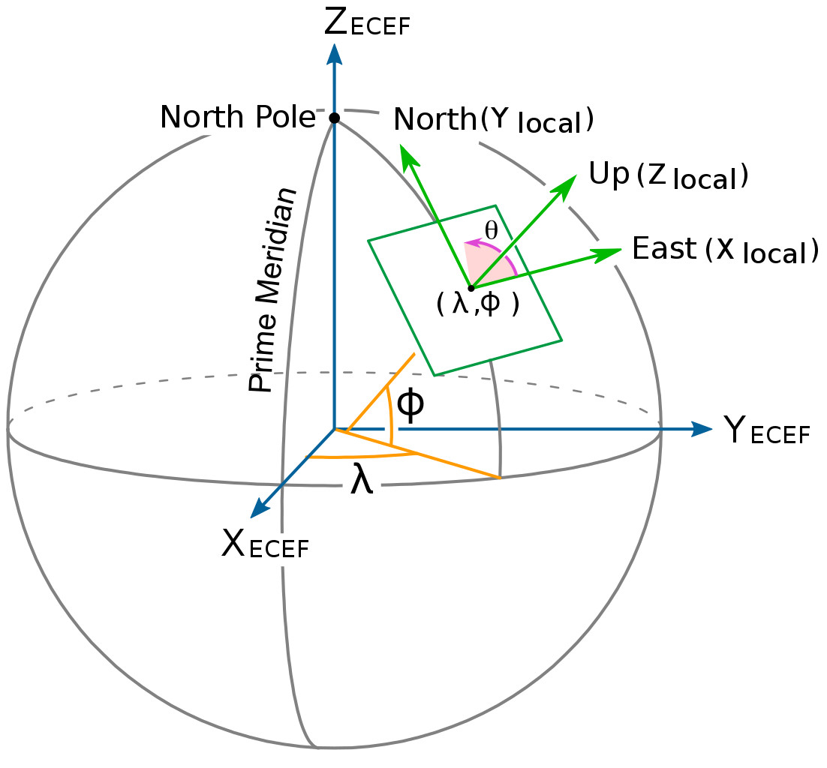
GIS fundamentals: Geographic coordinate systems (GCS)
A point is referenced by its longitude and latitude, which are angles measured from the Earth’s center to a point on its surface.
Latitude is also the angle from Polaris to horizon (in N. hemisphere)
Latitude and longitude are measured either in decimal degrees or in degrees, minutes and seconds.
Notes:
Now we’re going to move into coordinate systems, another super basic and important topic in GIS – these systems are the main way that we georeference or add specific location information onto a dataset to represent it in a GIS.
A GCS is a reference system for the curved surface of the earth – lat/long represents the angle of displacement from the origin.
1

Slide 25
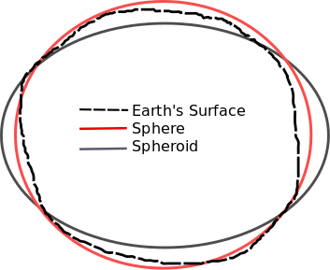
GIS fundamentals: Geographic coordinate systems (GCS)
The shape and size of a GCS’s surface is defined by a sphere or a spheroid
In fact, the Earth is neither a perfect sphere nor spheroid (the South Pole is closer to the equator than the North pole!)
A datum defines the origin and orientation of latitude and longitude lines.
Changing a GCS’s spheroid or datum changes all values!
The standard global system is called World Geodetic System 1984 (WGS1984)
Notes:
But of course the earth’s surface isn’t actually a sphere or even spheroid – so different coordinate systems are more accurate for different parts of the world.
The standard system WGS1984 is helpful in that its globally recognized but its less accurate in some places on the earths surface and if you work internationally you probably know that in other countries they often use their own systems.
1

Slide 26
GIS fundamentals: Geographic coordinate systems (GCS)
WGS84
Default Datum for GPS units
Pretty good for global measurements
Small changes in landmass movements can be significant at global scale
Melting glaciers cause rising elevation
Tectonic movements
Local datums are better for local maps (e.g., North American Datum; NAD83) and reduce significance of landmass movements.

Slide 27
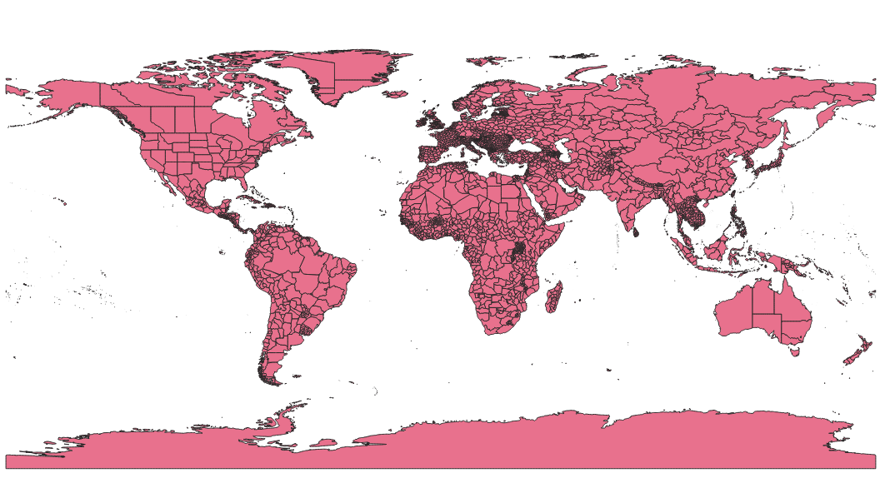
GIS fundamentals: Geographic coordinate systems (GCS)
WGS84 – Unprojected: Distortion near extents of map
Default Datum for GPS units
Pretty good for global measurements
Small changes in landmass movements can be significant at global scale
Melting glaciers cause rising elevation
Tectonic movements
Local datums are better for local maps (e.g., North American Datum; NAD83) and reduce significance of landmass movements.

Slide 28
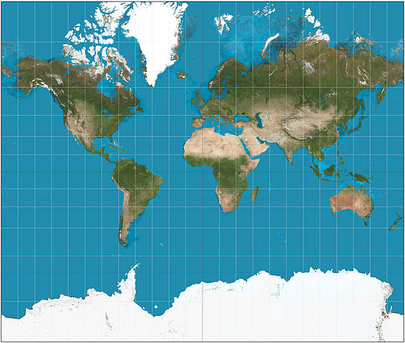
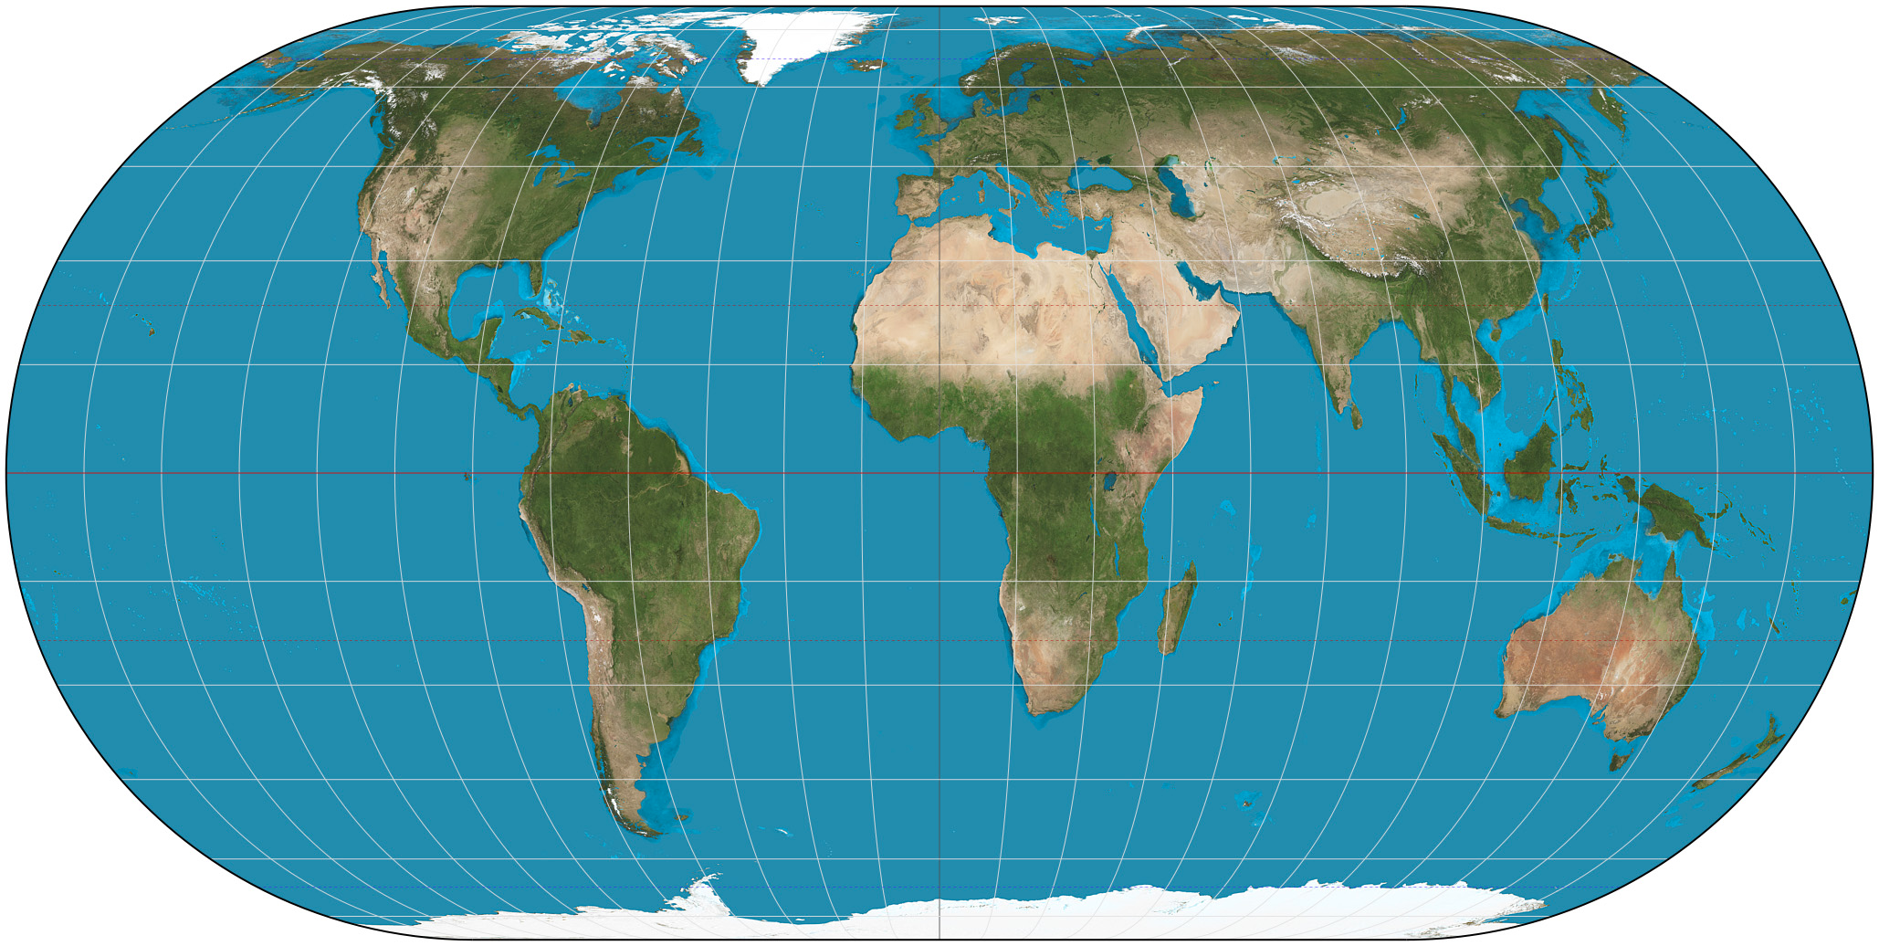
GIS fundamentals: Projected coordinate systems (PCS)
Representing the earth's surface in two dimensions causes distortion in the shape, area, distance, or direction of the data.
Impossible to show spherical object in 2 dimensions without distortion
A map projection uses mathematical formulas to relate spherical coordinates on the globe to flat, planar coordinates.
Different projections are designed to minimize different distortions.
Eckert IV: maintains area
Mercator: maintains direction
Notes:
Same goes for Projected coordinate systems, which are reference systems for features on a flat (projected) surface.
Eckert or UTM and other equal area projections minimize area distortion – so you should use that when calculating area, etc.
1

Slide 29
GIS fundamentals: Projected coordinate systems (PCS)
Representing the earth's surface in two dimensions causes distortion in the shape, area, distance, or direction of the data.
A map projection uses mathematical formulas to relate spherical coordinates on the globe to flat, planar coordinates.
Different projections are designed to minimize different distortions.
Eckert IV: maintains area
Mercator: maintains direction
Notes:
Same goes for Projected coordinate systems, which are reference systems for features on a flat (projected) surface.
Eckert or UTM and other equal area projections minimize area distortion – so you should use that when calculating area, etc.
1

Slide 30
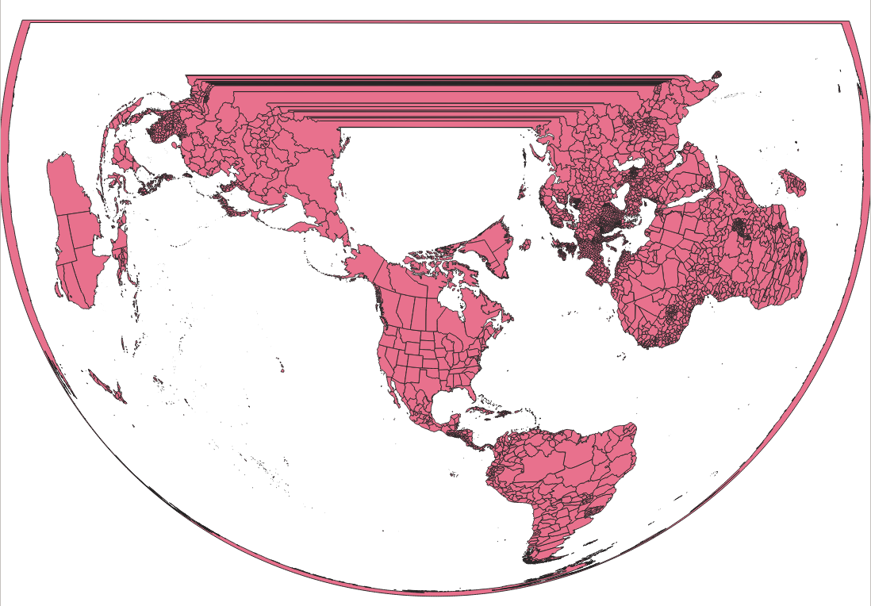
GIS fundamentals: Projected coordinate systems (PCS)
Representing the earth's surface in two dimensions causes distortion in the shape, area, distance, or direction of the data.
A map projection uses mathematical formulas to relate spherical coordinates on the globe to flat, planar coordinates.
Different projections are designed to minimize different distortions.
Eckert IV: maintains area
Mercator: maintains direction
Notes:
Same goes for Projected coordinate systems, which are reference systems for features on a flat (projected) surface.
Eckert or UTM and other equal area projections minimize area distortion – so you should use that when calculating area, etc.
1

Slide 31
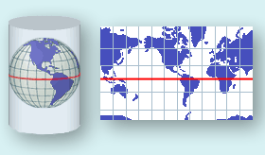
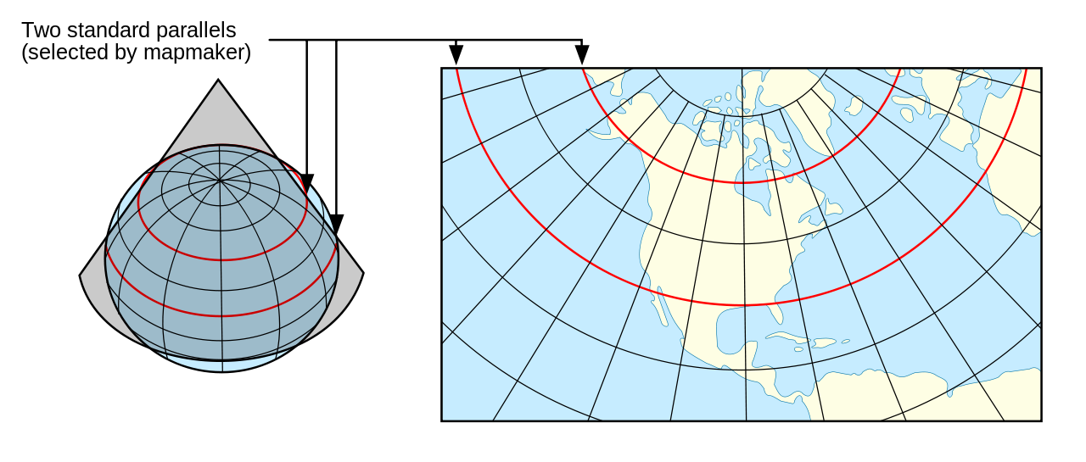
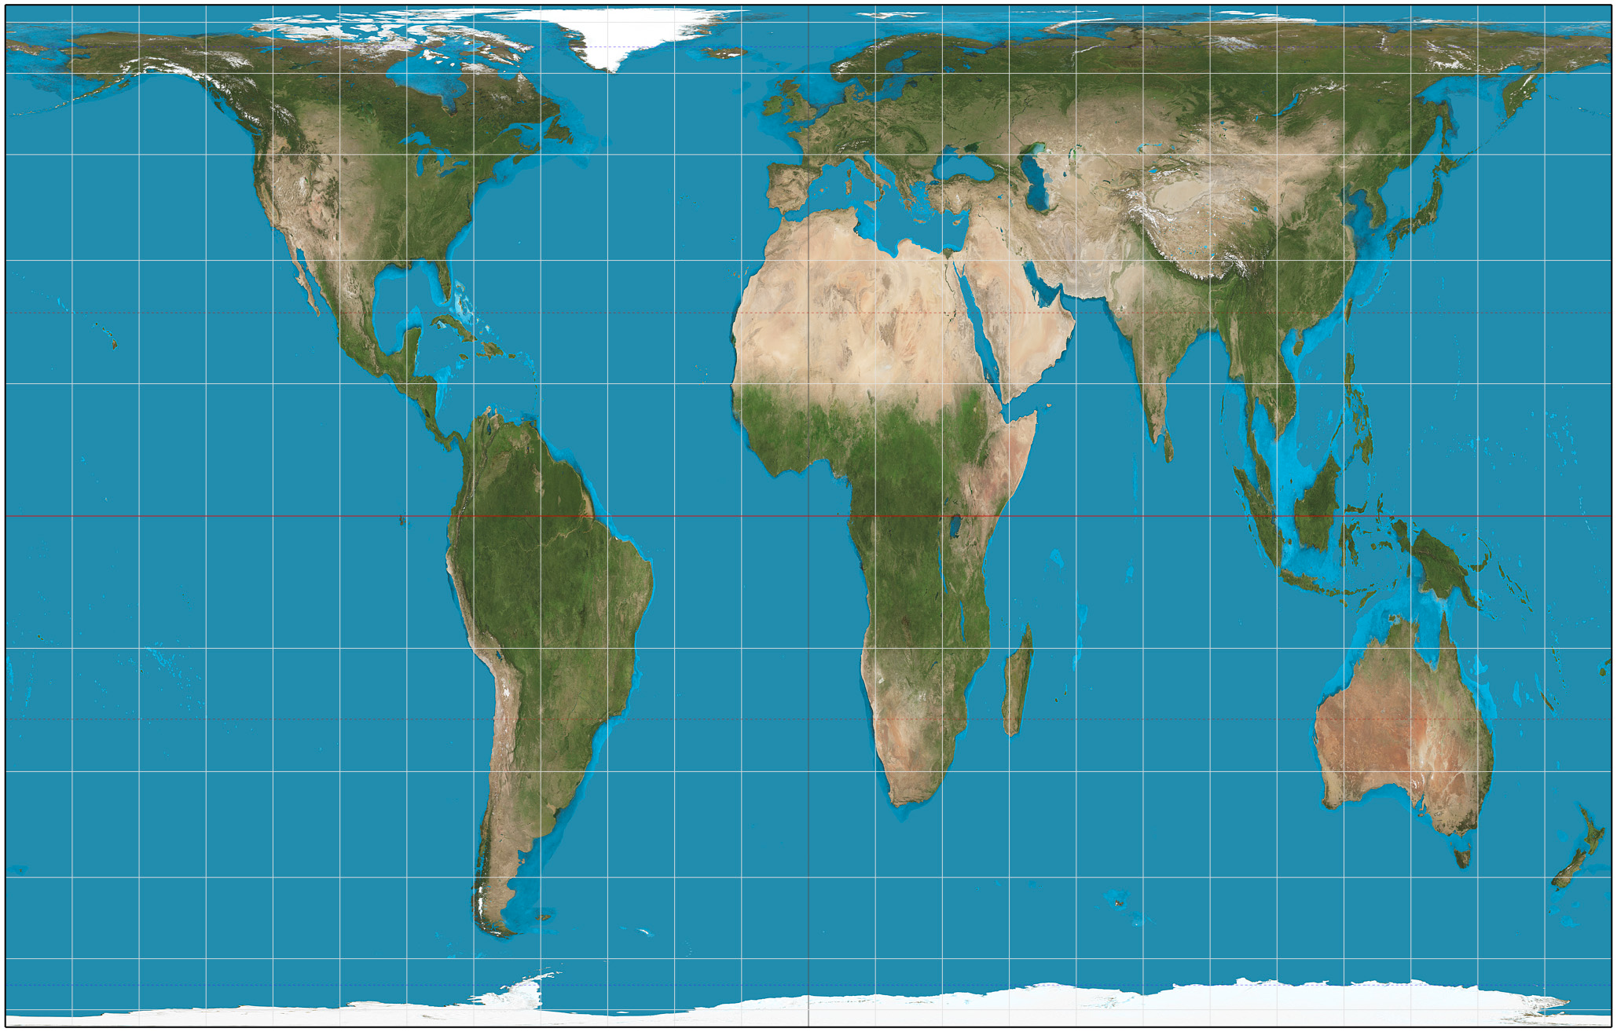


GIS fundamentals: Projected coordinate systems (PCS)
Conic Projection
- Maintains area near center
- Distortion near edges
- Good for east/west because
distortion constant
Mercator Projection
- Maintains direction
- Good for navigating
- Distorts near pole, pretty good near equator
Gall-Peters Projection
- Maintains relative areas
- High distortion
https://thetruesize.com/

Slide 32
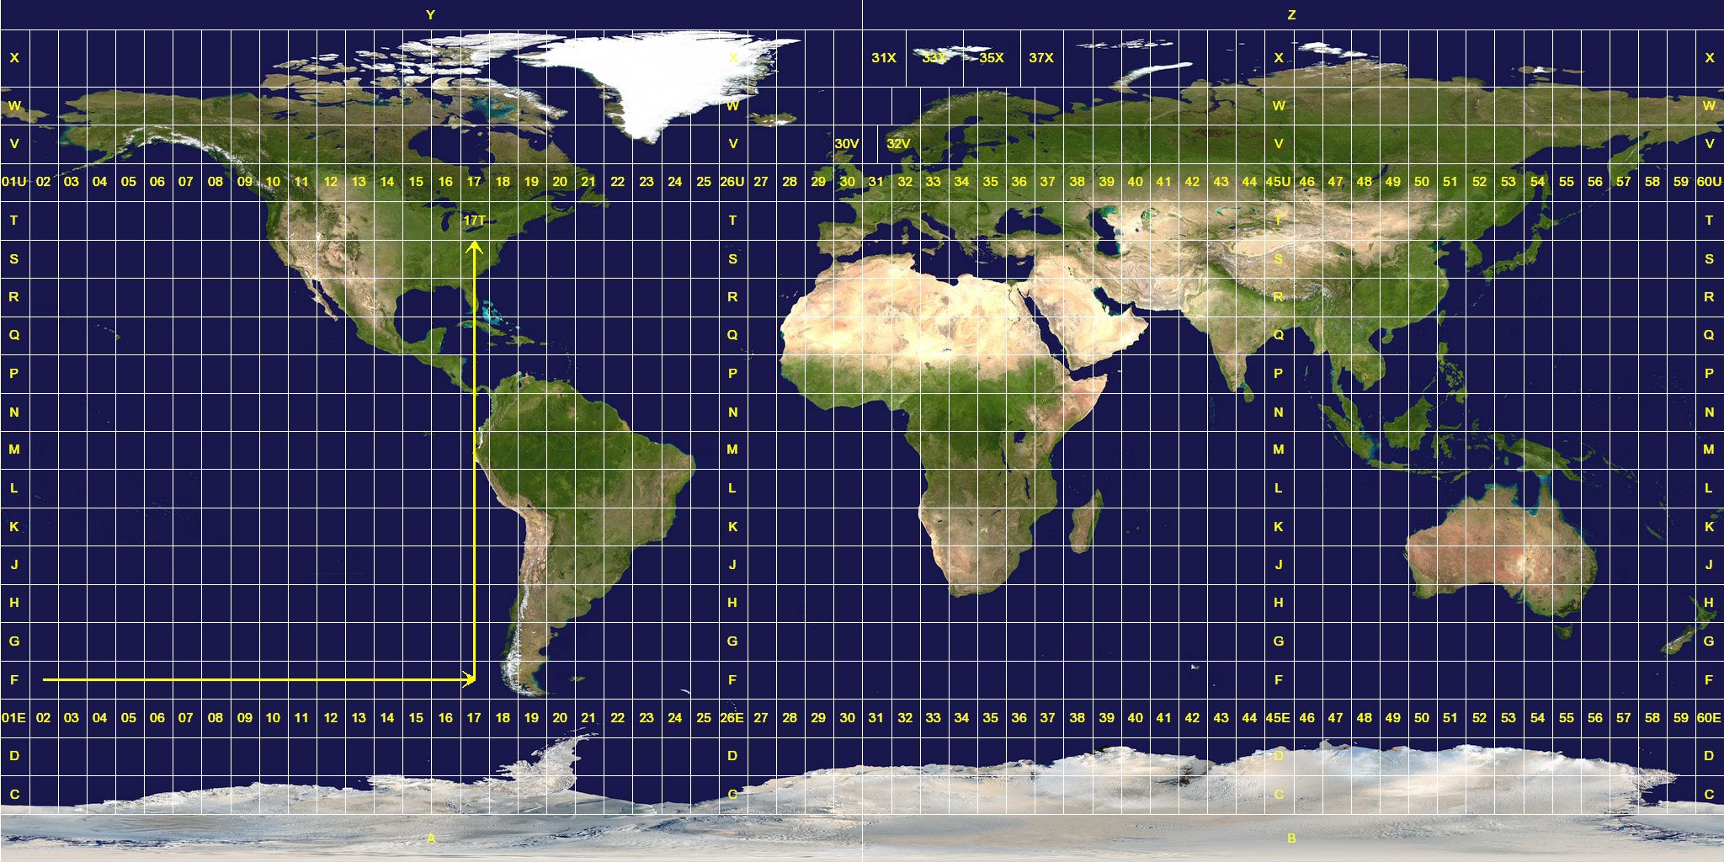
GIS fundamentals: Projected coordinate systems (PCS)
Universal Transverse Mercator - UTM
- Highly accurate within zone
- Measurement is in meters
- intuitive
- Not great for large areas
(across zones)

Slide 33
GIS fundamentals: Geographic and Projected coordinate systems
Modern GIS make dealing with coordinate systems relatively straightforward; however:
IT IS ESSENTIAL TO KNOW THE COORDINATE SYSTEM OF ANY DATA WITH WHICH YOU ARE WORKING!

Slide 34
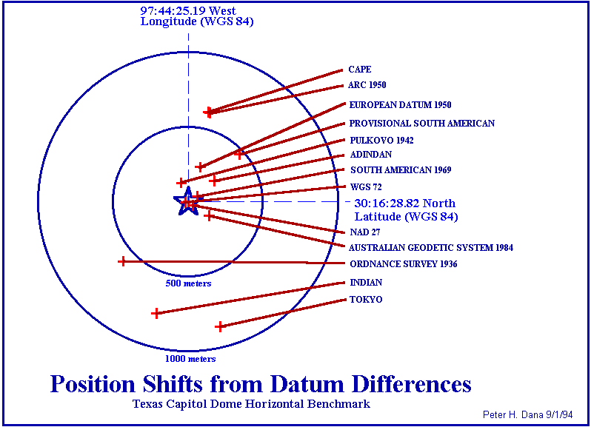
Notes:
Coordinate values resulting from interpreting latitude, longitude, and height values based on one datum as though they were based in another datum can cause position errors in three dimensions of up to one kilometer.
1

Slide 35
Outline
How do we represent real world geographic information with a computer?
Data models – representations of geographic reality
Scale, spatial autocorrelation
Location information: coordinate systems
Georeferencing, sampling bias
Remote Sensing
Notes:
Basic topics that are really the foundation you need to do any spatially explicit analyses.- with a focus on natural history questions since we r here.
1

Slide 36
Species’ distribution data: possible sources
Personal collection during field surveys (e.g., using a GPS receiver or smartphone)
Extracting data from large surveys (e.g., North American Breeding Bird Survey)
Digitizing atlases (e.g. The new atlas of breeding birds in Britain and Ireland: 1988-1991)
Collections in natural history museums
On-line distributed databases (e.g. GBIF, HerpNET, FishNET, ORNIS)
Notes:
1
In the kind of work that interests us here at the Museum – we’re often dealing with vector points of species information and then related that to rasterized environmental variables – though of course we’re doing lots of other things too.
Where do our species distribution data come from?
Today we’ll be doing a field survey of our own this afternoon with GPS units and smartphones - and carry forward our important discussion about error in these datasets – and how they can lead to sampling bias etc later on in analyses.

Slide 37
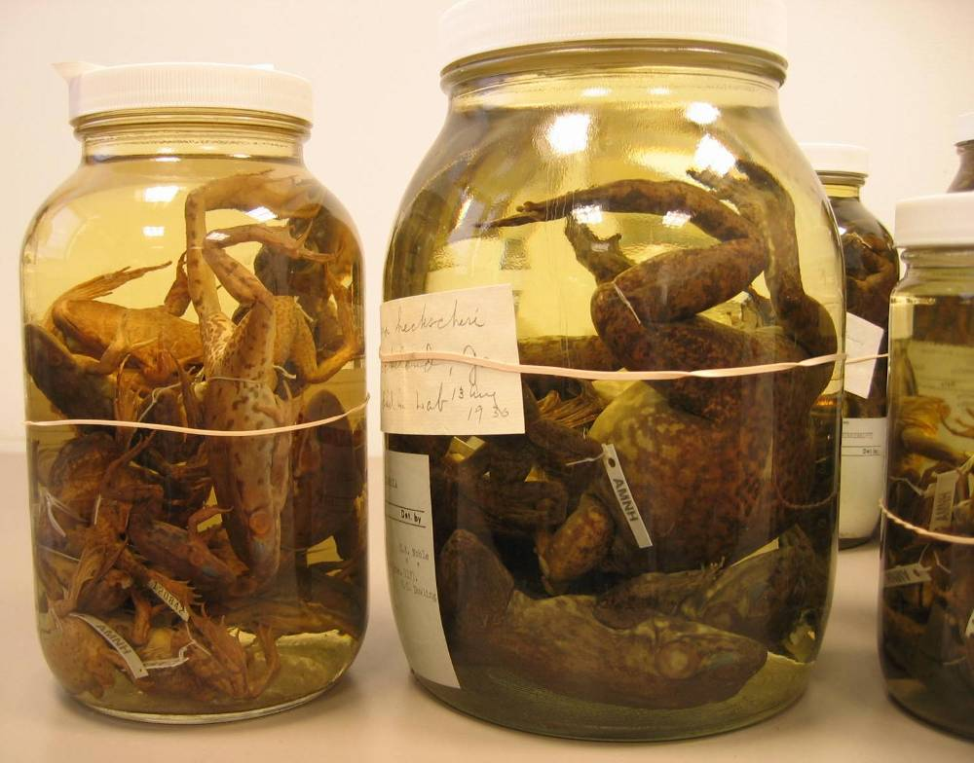
Georeferencing
Woodbury, NY
Near Woodbury
5 miles from Woodbury
1 mile east of Woodbury
10 minutes along the path leading out of Woodbury
Notes:
1

Slide 38
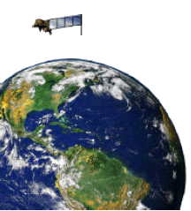
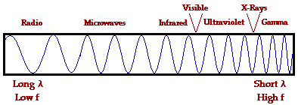
What is Remote Sensing?
General definition: Acquiring information about an object without physical contact.
Definition in context of Earth observation: A technology for sampling reflected and emitted electromagnetic (EM) radiation of features on the Earth's land surface, oceans, and atmosphere.
Source: P. Ersts, July 2004
Notes:
1
I didn’t want to end today without a very brief discussion about remote sensing because its such an important method for how we get environmental variables of interest – and the process by which we get these variables includes a lot of potential sources of error that are important to know about at the outset of any project.
Remote sensing can be defined in different ways. The most general definition is “acquiring information about an object without physical contact.” For our purposes, it is a technology for sampling reflected and emitted electromagnetic radiation of features on the Earth’s land surface, oceans, and atmosphere. Some people include the use of sound waves in the definition of remote sensing, but we will stick to electromagnetic radiation.

